Slide 1

Core Patterns
for Coding with AI
Lada Kesseler

Slide 2

What results are you getting when working with AI?

Slide 3
Good Results

Slide 4


Task
Context Window

Slide 5
Bad Results

Slide 6
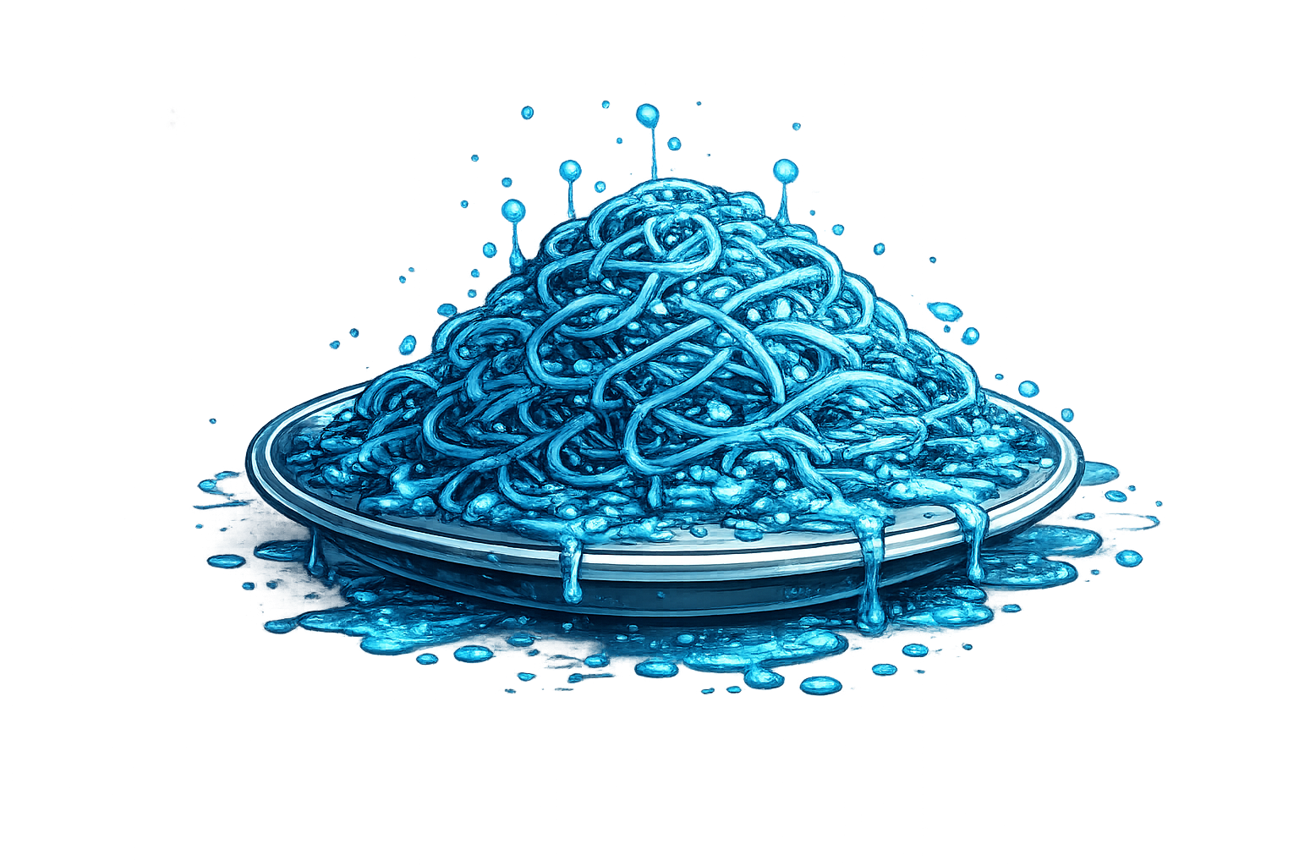
Task
Context Window

Slide 7
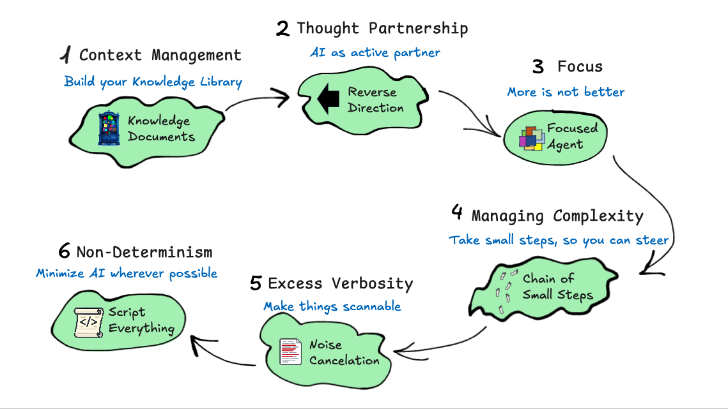
AI Slop

Slide 9
Resources
https://github.com/lexler/Talks/blob/main/core_patterns_for_coding_with_ai.md

Slide 10
Why are we getting bad results?

Slide 11


Relevant Knowledge
Task A
Task B
Context Window
Context Window

Slide 12

Relevant Knowledge
Task B
More instructions
More instructions
Context Window

Slide 13
Relevant Knowledge
Task B
More instructions
More instructions
Context Window

Slide 14
Relevant Knowledge
Task B
More instructions
More instructions
Context Window

Slide 15

Knowledge Documents

Slide 16
Relevant Knowledge

Slide 17
History
TODO.md
CLAUDE.md

Slide 19
Is there a way to know what knowledge it needs?

Slide 20
Relevant Knowledge
?
Task
?
Context Window

Slide 21

go do task

Slide 22
work with me
Reverse Direction

Slide 23
Relevant Knowledge
Task
?
Ask me anything unclear
?
?
?
Context Window

Slide 24
Relevant Knowledge
?
Task
?
Tell me what you plan to do before you do it
1
2
4
Context Window

Slide 25
Relevant Knowledge
?
3
Task
?
Tell me what you plan to do before you do it
1
2
3
4
Context Window

Slide 26
Relevant Knowledge
?
Task
?
Give me options
A
B
C
Context Window

Slide 27
Relevant Knowledge
use
B
Task
?
Give me options
A
B
C
Context Window

Slide 28
Relevant Knowledge
Task
?
Criticize my plan
?
Context Window

Slide 29
Ask me anything unclear
Tell me what you plan to do, before you do it
Give me options
Criticize my plan

Slide 30
work with me
Reverse Direction

Slide 32
Knowledge Documents

Slide 33
Possibly
Relevant
Knowledge
?
?
?
?
?
?
?
?
?
?
?
?
?
?
?
?
?
?
?
?
?
?
?
?
Task
?
Context Window

Slide 34

Seven sentences about one thing
A unit test should test one thing at a time
A unit test should be small and focused
A unit test should run fast
A unit test should be deterministic
A unit test should not depend on external systems
A unit test should clearly express its intent
A unit test should fail for only one reason
Focused Agent
Seven sentences about seven different things
Start with a clear purpose: write down the problem you're solving and who it's for
Involve the right people early, especially those who will use or maintain the system
Break work into small, testable increments that can be completed in days, not months
Keep the main branch always releasable through continuous integration
Automate builds, tests, and linting so quality checks are not optional
Write code that optimizes for readability over cleverness
Document decisions (why), not just APIs (what)
Distracted Agent

Slide 35
Focused Agent
Dedicated Task
Context Window

Slide 36
Relevant Knowledge
?
?
?
?
?
?
?
?
?
?
Task
Task
Context Window
Context Window

Slide 37
Focused Agent

Slide 38
History
SKILLS

Slide 40
But what if all the knowledge is relevant because the task is really big?

Slide 41
Relevant Knowledge
Task
Context Window

Slide 42

Managing Complexity

Slide 43
Relevant Knowledge
independently
Task 1
Task 2
Task 3
Context Window
Context Window
Context Window
Independent Tasks

Slide 44
Relevant Knowledge
Task 1
Task
Task 2
recency bias
Task 3
Context Window
Context Window

Slide 45

Chain of Small Steps

Slide 46
Relevant Knowledge
Task 4
Task 5
Steer
Context Window

Slide 47
Continuing in a New Context
Task 1
Task 4
Task 2
Task 3
end of context
Context Window
New Context

Slide 48
Chain of Small Steps

Slide 52
Bla bla?
Bla blabla bla bla. Bla bla bla, bla bla bla bla blabla bla. Blabla? Bla bla bla bla: 1. Bla?
2. Bla bla blabla?
3. Bla bla blablabla?
4. Blablabla bla bla bla?
5. Bla bla?
6. Blabla?
7. Bla bla?
8. Blabla bla bla?
9. Bla bla blabla bla bla. Bla? 10. Bla bla bla?
Bla blabla bla blabla bla!
Ask me only one question at a time
You’re absolutely right!
Bla bla blablabla bla bla.
Bla bla?
Context Window

Slide 53
Bla bla?
Bla blabla bla bla... Bla bla bla, bla bla bla bla blabla bla. Blabla bla bla bla bla. Bla bla blabla bla bla bla blabla. Bla bla bla blabla bla bla. Blablabla bla bla bla bla bla. Bla bla blabla bla! Blabla bla bla bla. Bla bla blabla bla. Blabla bla bla bla bla. Bla bla blabla bla bla bla bla bla. Bla bla bla blabla. Bla blabla bla blabla bla?
Much more succinct please
Bla bla bla bla, bla bla. Bla
bla blabla? Bla bla?
Context Window

Slide 54
Zoom out:
“Make it shorter”
”Make it more succinct”
“Describe architecture on the high level”
“Give me a TLDR of this”
makes the meaning scannable
really helps with doc maintainability

Slide 55

Noise Cancellation

Slide 57
Task 1
Task 2 (linting)
lint.sh
Task 2 (linting)
Task 3
Context Window
Context Window

Slide 58
Task 1
Run lint.sh
deterministic!
Task 3
Script Everything Scriptable
Context Window

Slide 59

Script Everything
(Offload Deterministic)

Slide 61
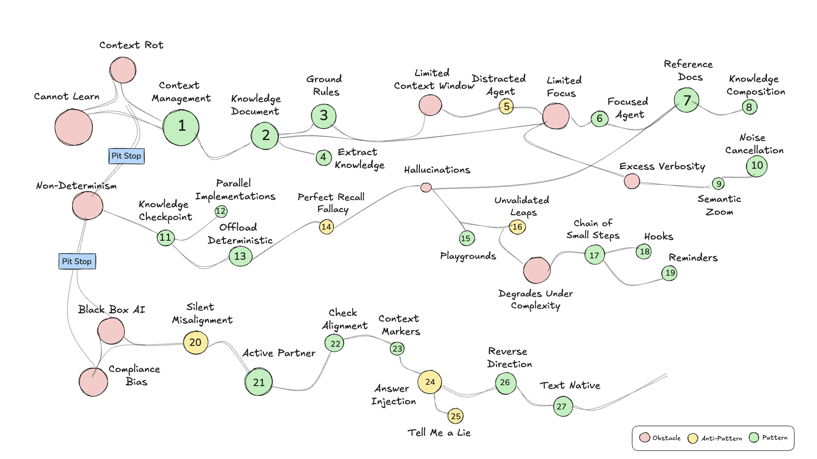
Resources
https://github.com/lexler/Talks/blob/main/core_patterns_for_coding_with_ai.md

Slide 62
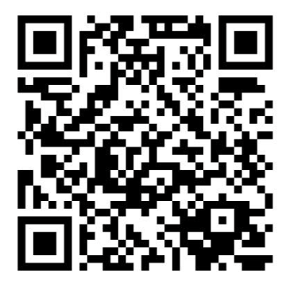
Thank you!

